Slide 1
Session 2 of Data Science II
Notes:
Thank you everyone for joining these multi-sessions workshop on using data science frameworks,libraries and tools mainly in Python to explore in details how to start making your own Machine Learning projects. This course, I assume that most of you have at least basic understanding of Python, declaring functions, loops, importing libraries etc… I won’t go in detail in the python code unless it is vital. After this sessions ends if what you see is giberish, let me know and I will try to give you some extra python resources to get you up to speed.
Anyone, My name is Ahmed Al-Manji, I worked as technical analyst of startups and currently Master’s Student in Data Science. I hope that you will learn enough from me that will bootstrap your Data science, or machine learning career path.

Slide 2
Topics for Today
Recap from yesterday’s EDA and Feature Engineering
Discuss the mathematics and logic behind some ML Algos
Logistic Regression
Support Vector Machines (SVM)
K-Nearest Neighbor (KNN)
Naïve Bayes
Decision Tree
Coding Session

Slide 3
Pre-Installing
#### YOU NEED TO INSTALL THIS => brew install graphviz
### -> Link https://graphviz.gitlab.io/download/
pip install scikit-learn

Slide 4
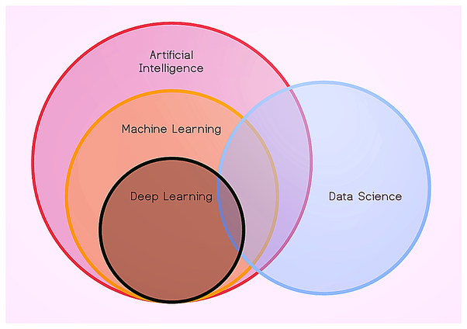
The Buzz Words
Notes:
Now how is Data science related to all other buzzwords:
Basically we are using data techniques to get the data clean and analyze what we are looking for etc… and then use algorithms to predict what’s next.
One way of defining AI is that it’s a collection of mathematical algorithms that make computers understand relationships between different types and pieces of data such that this knowledge of connections could be utilised to come to conclusions or make decisions that could be accurate to a very high degree.
Machine Learning (ML) is considered a sub-set of AI. You can even say that ML is an implementation of AI. So whenever you think AI, you can think of applying ML there when there is enough data. We will talk more about ML tmw inshallah.
Deep Learning is normal terms basically Machine Learning on steroids, where when you have a lot, and I mean a lot of data you can use it and also when you want the accuracy to be very very high.
So ML use cases examples is predicting sales or when Netflix tells you what you should watch next.
DL is for example Alexa or siri… And if you heard about TensorFlow or PyTorch there are basically Deep Learning tools.

Slide 5
ML Thesaurus : Prediction
Name | Age | Statistics Mark | Python Mark | Height | Second Language |  | Target (Mark) | Prediction
Ahmed | 26 | 5 | 4 | 175 | Spanish |  | 5 | 4.5
Khalil | 42 | 4 | 5 | 182 | Russian |  | 4 | 4.5
Cholo | 33 | 5 | 5 | 170 | Swahili |  | 5 | 5
Hamood | 29 | 3 | 4 | 178 | English |  | 5 | 3.5
Some Student | 27 | 3 | 3 | 158 | German |  | 2 | 3
Notes:
The prediction contains values we predicted using some model.
Different models can give you different results/ We are not just talking ML so bear with me.

Slide 6
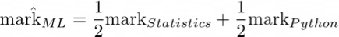
ML Thesaurus : Prediction
Name | Age | Statistics Mark | Python Mark | Height | Second Language |  | Target (Mark) | Prediction
Ahmed | 26 | 5 | 4 | 175 | Spanish |  | 5 | 4.5
Khalil | 42 | 4 | 5 | 182 | Russian |  | 4 | 4.5
Cholo | 33 | 5 | 5 | 170 | Swahili |  | 5 | 5
Hamood | 29 | 3 | 4 | 178 | English |  | 5 | 3.5
Some Student | 27 | 3 | 3 | 158 | German |  | 2 | 3
Notes:
The prediction contains values we predicted using some model.
Different models can give you different results/ We are not just talking ML so bear with me.

Slide 7
ML Thesaurus : Prediction
Name | Age | Statistics Mark | Python Mark | Height | Second Language |  | Target (Mark) | Prediction
Ahmed | 26 | 5 | 4 | 175 | Spanish |  | 5 | 1
Khalil | 42 | 4 | 5 | 182 | Russian |  | 4 | 5
Cholo | 33 | 5 | 5 | 170 | Swahili |  | 5 | 2
Hamood | 29 | 3 | 4 | 178 | English |  | 5 | 4
Some Student | 27 | 3 | 3 | 158 | German |  | 2 | 3
Notes:
The prediction contains values we predicted using some model.
Different models can give you different results/ We are not just talking ML so bear with me.

Slide 8
ML Thesaurus : Prediction
Name | Age | Statistics Mark | Python Mark | Height | Second Language |  | Target (Mark) | Prediction
Ahmed | 26 | 5 | 4 | 175 | Spanish |  | 5 | 1
Khalil | 42 | 4 | 5 | 182 | Russian |  | 4 | 5
Cholo | 33 | 5 | 5 | 170 | Swahili |  | 5 | 3
Hamood | 29 | 3 | 4 | 178 | English |  | 5 | 2
Some Student | 27 | 3 | 3 | 158 | German |  | 2 | 4
Notes:
The prediction contains values we predicted using some model.
Different models can give you different results/ We are not just talking ML so bear with me.

Slide 9
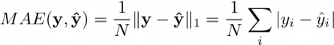
ML Thesaurus : Loss Function
Error |  | Target (Mark) | Prediction
4 |  | 5 | 1
1 |  | 4 | 5
3 |  | 5 | 2
1 |  | 5 | 4
1 |  | 2 | 3
Mean Absolute Error (where y is vector of targets)
Notes:
Loss function measures the error rate of our model.

Slide 10
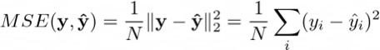
ML Thesaurus : Loss Function
Error |  | Target (Mark) | Prediction
16 |  | 5 | 1
1 |  | 4 | 5
9 |  | 5 | 2
1 |  | 5 | 4
1 |  | 2 | 3
Mean Squared Error (where y is vector of targets)
Notes:
Loss function measures the error rate of our model.

Slide 11
ML Thesaurus : Parameters
Name | Age | Statistics Mark | Python Mark | Height | Second Language |  | Target (Mark) | Prediction
Ahmed | 26 | 5 | 4 | 175 | Spanish |  | 5 | 4.5
Khalil | 42 | 4 | 5 | 182 | Russian |  | 4 | 4.5
Cholo | 33 | 5 | 5 | 170 | Swahili |  | 5 | 5
Hamood | 29 | 3 | 4 | 178 | English |  | 5 | 3.5
Some Student | 27 | 3 | 3 | 158 | German |  | 2 | 3
Notes:
To learn something, our model needs some degrees of freedom:

Slide 12
ML Thesaurus : Parameters
Name | Age | Statistics Mark | Python Mark | Height | Second Language |  | Target (Mark) | Prediction
Ahmed | 26 | 5 | 4 | 175 | Spanish |  | 5 | 4.447
Khalil | 42 | 4 | 5 | 182 | Russian |  | 4 | 4.734
Cholo | 33 | 5 | 5 | 170 | Swahili |  | 5 | 5.101
Hamood | 29 | 3 | 4 | 178 | English |  | 5 | 3.714
Some Student | 27 | 3 | 3 | 158 | German |  | 2 | 3.060
Notes:
To learn something, our model needs some degrees of freedom:

Slide 13
ML Thesaurus : hyperparameters
Name | Age | Statistics Mark | Python Mark | Height | Second Language |  | Target (Mark) | Prediction
Ahmed | 26 | 5 | 4 | 175 | Spanish |  | 5 | 4.447
Khalil | 42 | 4 | 5 | 182 | Russian |  | 4 | 4.734
Cholo | 33 | 5 | 5 | 170 | Swahili |  | 5 | 5.101
Hamood | 29 | 3 | 4 | 178 | English |  | 5 | 3.714
Some Student | 27 | 3 | 3 | 158 | German |  | 2 | 3.060
Notes:
Find Good Hyperparameter definition

Slide 14

Supervised Machine Learning Statement
Let’s denote:
Training Dataset , where
for regression
, for classification
Model predicts some value for every observation
Loss function that should be minimized
Notes:
Find Good Hyperparameter definition

Slide 15
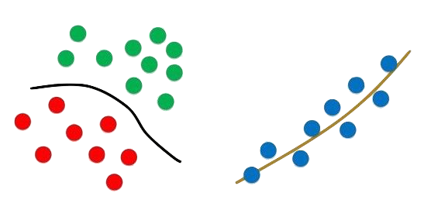
Classification vs Regression

Slide 16
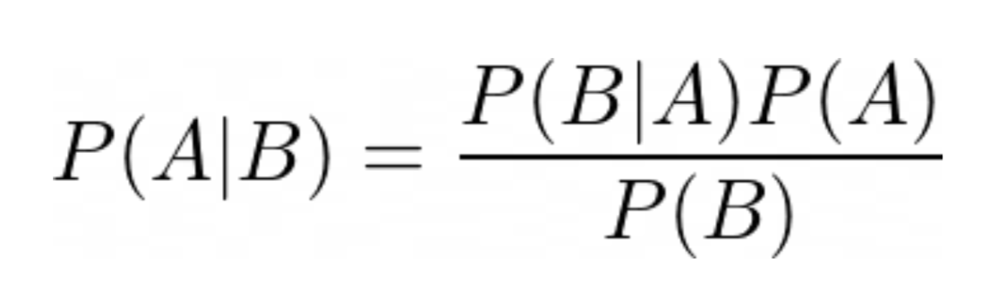
Naïve Bayes Classifier: Bayes Theorem
Notes:
Bayes Theorem:
In simple words: What is the probability of A given that B is true or occurred… However, one important thing with Bayes theorem is that A and B must be independent

Slide 17
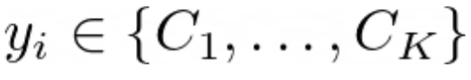
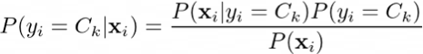

Naïve Bayes Classifier
Let’s denote:
Training Dataset , where
, for K-class classification
Notes:
It is a probabilistic classifier. I don’t know want go very deep in the math and get you bored and hate me.
But what NB does that in plain English does is that will give a probability for each classification based on what happened before to all the data.
Let’s take the Bayes Theorem and transform it our need where are going to get probability for each observation based on our features.
What we need is the class with maximum probability

Slide 18
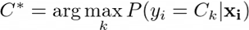
Naïve Bayes Classifier
Let’s denote:
Training Dataset , where
, for K-class classification
Optimal Class Label / Model
Notes:
It is a probabilistic classifier. I don’t know want go very deep in the math and get you bored and hate me.
But what NB does that in plain English does is that will give a probability for each classification based on what happened before to all the data.
Let’s take the Bayes Theorem and transform it our need where are going to get probability for each observation based on our features.
Without going further in the math,
However in my opinion and many others don’t use NB for your models unless your dataset is very small. Because imagine the computational cost (? do they know what it means). You have to calculate the probability of each feature for each observation and those numbers could grow really fast with the increasing of training samples.

Slide 19
K-Nearest Neighbor
K=3
K=5
Notes:
K-NN is basically you compare it depending on what is the closest value that know!
Given a new observation:
Calculate the distance to each of the samples in the dataset.
Select samples from the dataset with the minimal distance to them.
The label of the new observation will be the most frequent label among those nearest neighbors.

Slide 20
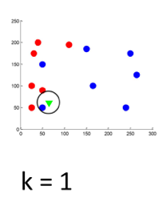
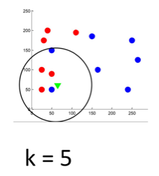
K-Nearest Neighbor – hyperparameter optimization
Notes:
Choosing the number of k is really important.

Slide 21
K-Nearest Neighbor – distance
https://medium.com/@srishtisawla/k-nearest-neighbors-f77f6ee6b7f5

Slide 22
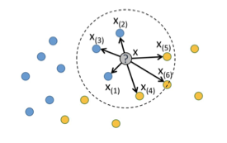
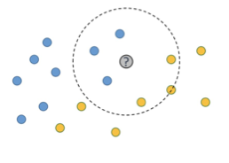
K-Nearest Neighbor – Weighted Neighbors
K=6

Slide 23
K-Nearest Neighbor – Weighted Neighbors
Weights Adjustments:
Neighbors Orders
Distance
Notes:
Applications of KNN :
If you’re searching for semantically similar documents (i.e., documents containing similar topics), this is referred to as Concept Search.
The biggest use case of K-NN search might be Recommender Systems. If you know a user likes a particular item, then you can recommend similar items for them.
Advantages :
No assumptions about data — useful, for example, for nonlinear data
Simple algorithm — to explain and understand/interpret
High accuracy (relatively) — it is pretty high but not competitive in comparison to better supervised learning models
Versatile — useful for classification or regression
Disadvantages :
Computationally expensive — because the algorithm stores all of the training data
High memory requirement
Prediction stage might be slow (with big N)
Sensitive to irrelevant features and the scale of the data.

Slide 24
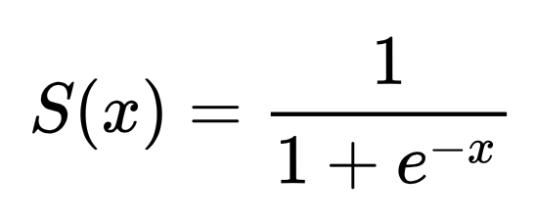
Logistic Regression
Notes:
The model builds a regression model to predict the probability that a given data entry belongs to the category numbered as “1”. Just like Linear regression assumes that the data follows a linear function, Logistic regression models the data using the sigmoid function.

Slide 25
Linear Classification

Slide 26
Support Vector Machines - SVMs

Slide 27
SVM

Slide 28
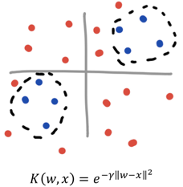
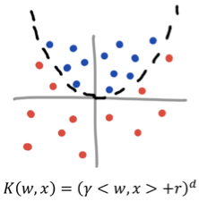
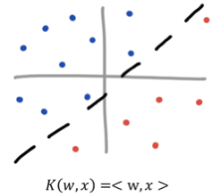
SVM – Kernel Tricks
Linear
Polynomial
RBF
Notes:
Gaussian radial basis function
In most cases you will use rbf -> I would assume maybe 99% of the time you will most likely want to use RBF and in some few cases polynomial

Slide 29
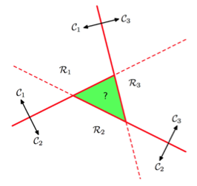
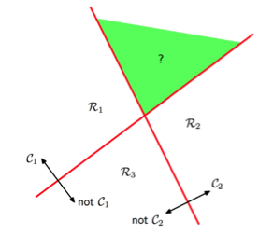
SVM – Multiclass Classification
One vs Rest
One vs One
Notes:
I don’t want to get deeper into this but there are many techniques that researchers and came up with that might be really good for specifc use cases.

Slide 30
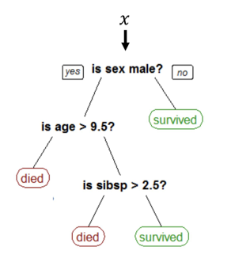
Decision Trees
{ age , sex , Sibsp }
= { 9 , male , 3 }

Slide 31
Decision Trees
Notes:
1. Make a split

Slide 32
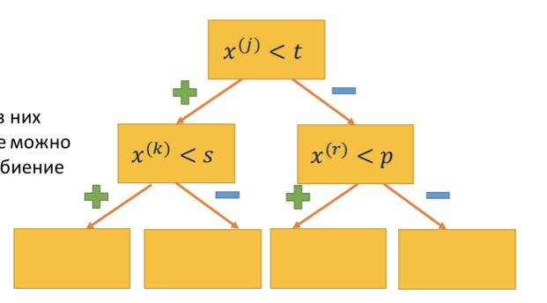
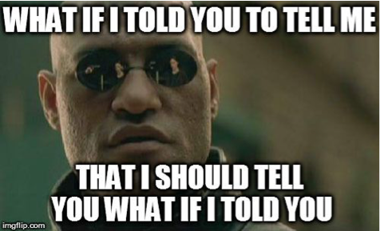
Decision Trees – Constructing Trees
1- Make Split
2- Repeat
3- Repeat
Notes:
1. Make a split

Slide 33
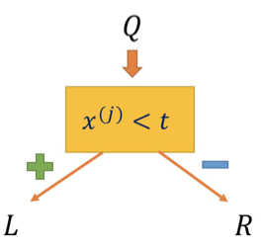
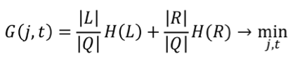
Decision Trees – How to Split Properly?
Notes:
Q – number of data observations
L –R how many data points go here and there
But what really important what is H (R)?
https://towardsdatascience.com/the-simple-math-behind-3-decision-tree-splitting-criterions-85d4de2a75fe

Slide 34
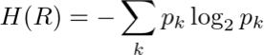
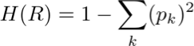
Decision Trees – Information criteria
Entropy Criteria :
Gini impurity :
Notes:
Q – number of data observations
L –R how many data points go here and there

Slide 35
The Titanic Dataset
Part3: Predictive Modelling
1) Running Basic Algorithms.
2)Cross Validation.
3) Ensembling.
4)Important Features Extraction.
Notes:
The sinking of the Titanic is one of the most infamous shipwrecks in history. On April 15, 1912, during her maiden voyage, the Titanic sank after colliding with an iceberg, killing 1502 out of 2224 passengers and crew. That's why the name DieTanic. This is a very unforgetable disaster that no one in the world can forget.
It took about $7.5 million to build the Titanic and it sunk under the ocean due to collision. The Titanic Dataset is a very good dataset for begineers to start a journey in data science and participate in competitions in Kaggle.
The Objective of this notebook is to give an idea how is the workflow in any predictive modeling problem. How do we check features, how do we add new features and some Machine Learning Concepts. I have tried to keep the notebook as basic as possible so that even newbies can understand every phase of it.

Slide 36

THANK YOU
Notes:
https://datasetsearch.research.google.com
https://playground.tensorflow.org/#activation=tanh&batchSize=10&dataset=circle&regDataset=reg-plane&learningRate=0.03&regularizationRate=0&noise=0&networkShape=4,2&seed=0.73561&showTestData=false&discretize=false&percTrainData=50&x=true&y=true&xTimesY=false&xSquared=false&ySquared=false&cosX=false&sinX=false&cosY=false&sinY=false&collectStats=false&problem=classification&initZero=false&hideText=false
http://arogozhnikov.github.io/2016/07/05/gradient_boosting_playground.html

